Slide 1
FUTURE COMPUTING AND
DNA HARD DRIVES
Naman Malhotra
814/BT/14

Slide 2
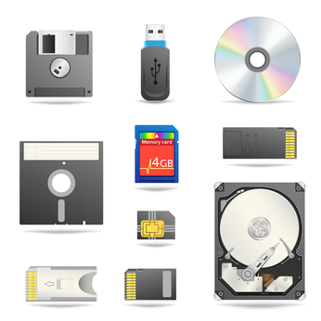
Problem with Traditional Forms of Data Storage
No longer adequate
To meet the exponential
Growth of data generated
AVG Capacity : 500 Gbit/in²
Source

Slide 3
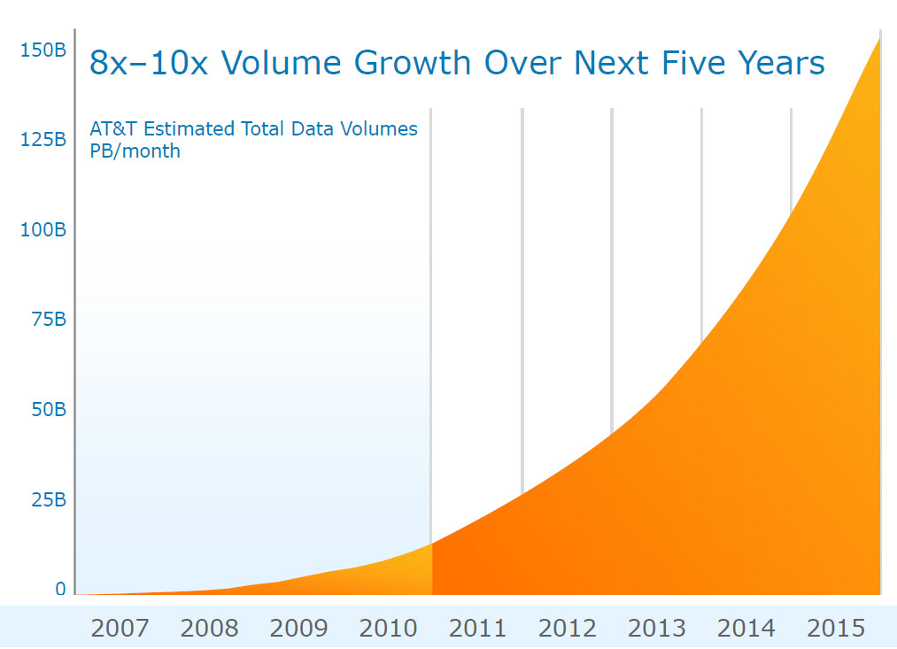
Why we need alternative form of DATA storage
90 percent of all the data in the world has been generated over the last two years.
Source

Slide 4
Towards practical, high-capacity, low-maintenance
information storage in synthesized DNA
Authors: Nick Goldman et al. (European Bioinformatics Institute)
Nature 494, 77–80 (07 February 2013) doi:10.1038/nature11875 Received 15 May 2012; Accepted 12 December 2012; Published online 23 January 2013

Slide 5
Introduction
The Maximum Storage Density on today’s devices as per august 8, 2016 is 1 Terabyte per square inch while the projected data demand would be 8000 Exabyte till 2020.
The current Storage Technologies definitely are not competent enough to handle it efficiently and archive it for the distant future.
For instance, the European Organization for Nuclear Research-CERN’s CASTOR (CERN Advanced Storage manager) system stores 0.08 Exabyte of Large Hadron Collider data and grows at 15 PB every year.

Slide 6
One Exabyte
1 Exabyte
10^3 Petabytes
10^9 Gigabytes

Slide 7
DNA as data Storage
1 Gram of DNA = 455 Exabyte
Capacity for high-density.
Durability under easily achieved conditions.
Track record as an information bearer.
(University of Copenhagen)
World's Oldest Genome Sequenced From 700,000-Year-Old Horse DNA.
Source

Slide 8
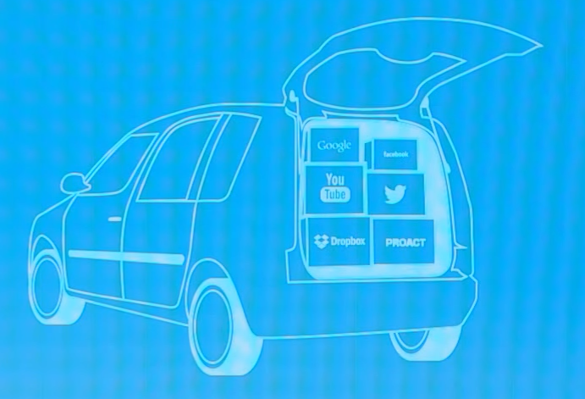
World’s Data in back of one vehicle
Source

Slide 9
Previous DNA-based storage approaches
Craig Venter Institute. (MaryLand, US) 2010
  In 2010 they were able to encode a 7920-bit watermark in the genome of bacteria.
  First attempt to encode, such a larger amount of information into DNA.
Church et al (Harvard) 2011
  Recovered 643 Kb message.
  Assigned 0 as A or C and 1 as T or G

Slide 10
Problem With Previous Methods
Trivial amounts of information.
Not easily scalable.
No robust error-correction.

Slide 11
New Methods
Hypothetical long molecule encoded in vitro using shorter DNA fragments.
Synthetic over living vectors.
Focus on Shorter fragments, as they are easier to encode and manipulate.

Slide 12
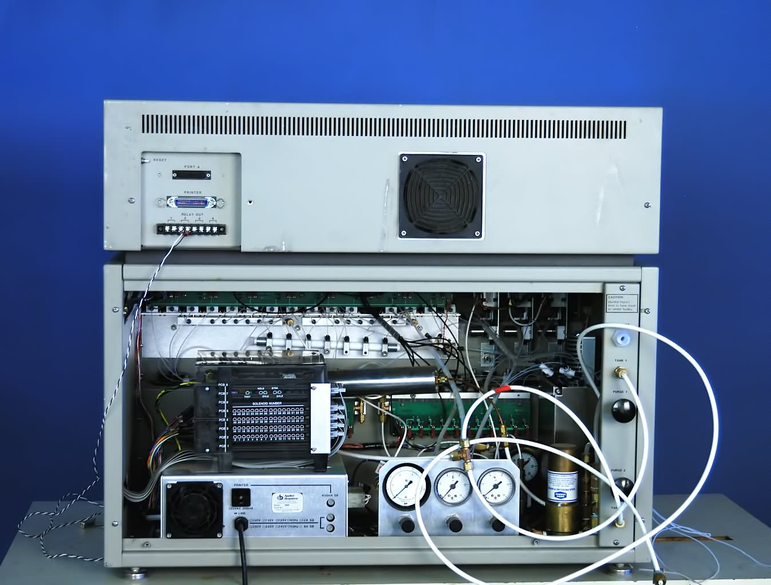
Encoding Device

Slide 13
The Data Encoded
Five files: 757,051 bytes total :-
  All 154 of Shakespeare's sonnets (ASCII)
  Classic scientific paper (PDF)
  Medium resolution color photo (JPEG)
  26-s excerpt from Martin Luther King's 1963 'I have a dream' speech (MP3)
  Huffman code used to convert bytes to base-3 digits (ASCII)

Slide 14
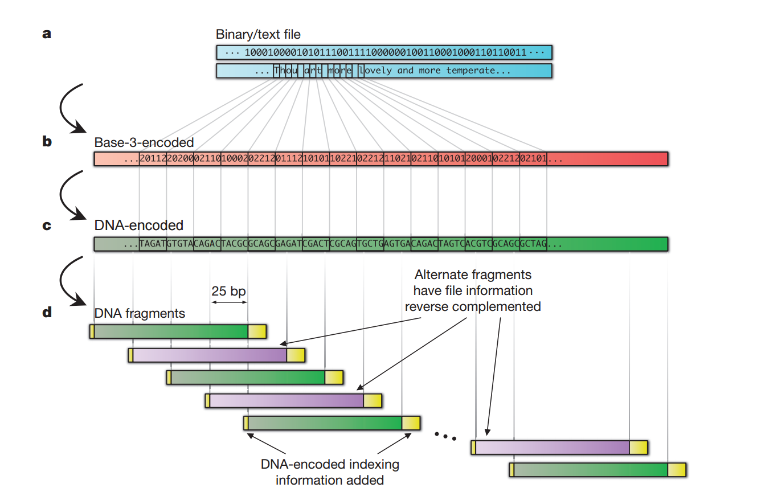
153,335 strings of DNA, each 117 nucleotides

Slide 15
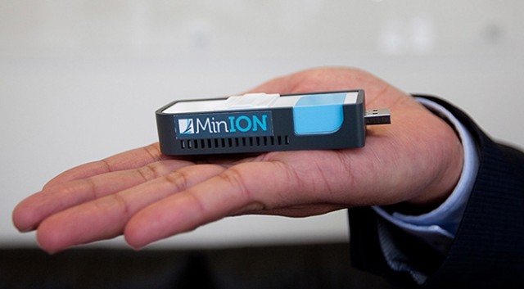

Decoding Device
Cost: $1000
Time Required: 6 hours

Slide 16
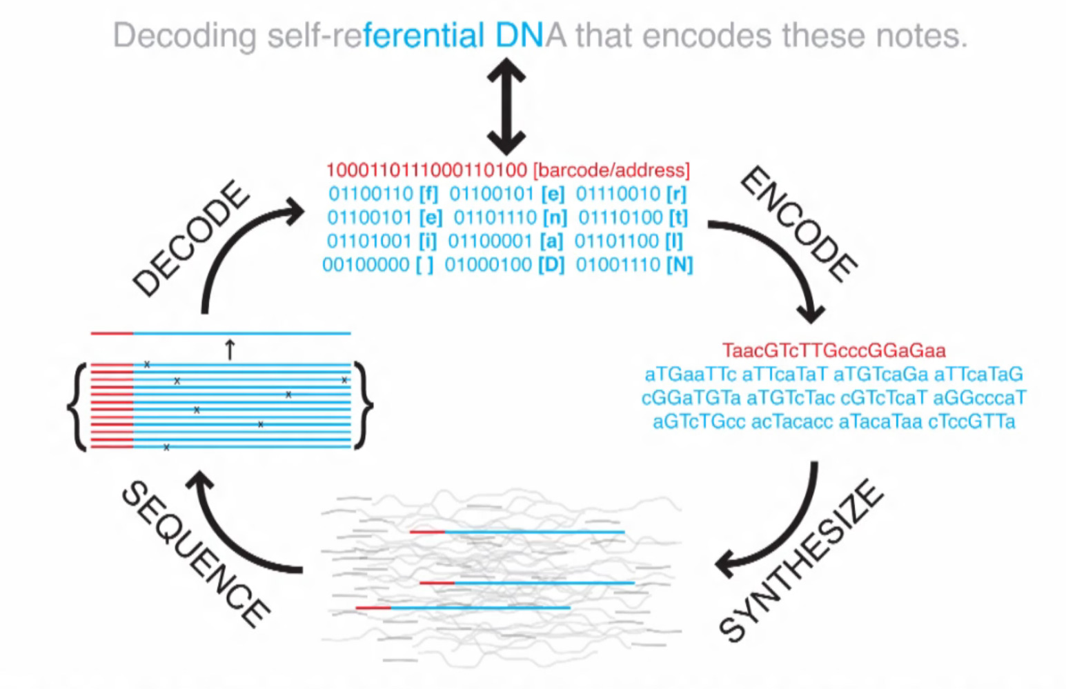
Source

Slide 17
Decoding Process
Full length (117 nt) DNA strings reconstructed in silico.
Discarded the redundant strings.
The DNA sequences representing all of the files were then reconstructed using sophisticated computer software.

Slide 18
The Challenges
Difficulty in synthesizing long sequences of DNA.
Cost of Writing the data into DNA is $11,000 / MB
Absence of error correction enzymes.
  Currently Solved by introducing redundancy.

Slide 19
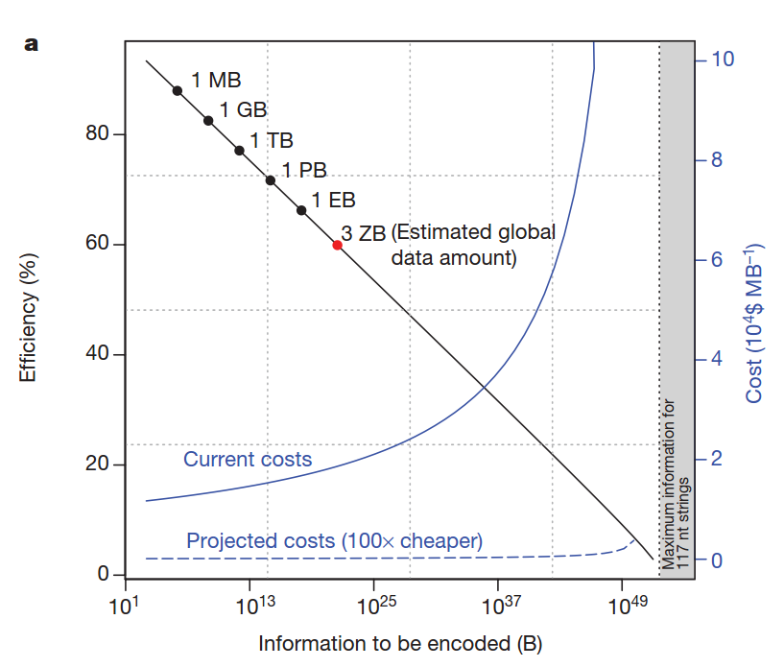
Scalability

Slide 20
Results
4 out of 5 files were fully decoded without intervention.
Fifth contained 2 gaps, 25 bases each.
Inspection of neighboring regions allowed to hypothesize missing fragments.
After manually inserting 50 bases, the original file had been reconstructed with 100% accuracy.

Slide 21
Conclusion
DNA would become a universal archival medium one day.
Our technological ineptness to unleash its full potential at present.
DNA in living cells have auto correction enzymes, no such artificial enzymes exist for artificial DNA.
Several breakthroughs will be required before it becomes commercially mainstream for data retrieval.

Slide 22
Work In progress.
Goldman et al. is working on, how to write data into DNA with minimum cost.
Team Lead by Luis Ceze, at Univ. of Washington. Has collaborated with Microsoft research.
  They are able to store 200MB of data.
  Understanding Error that crop up and how to deal with them.
Grass et al. recovered an 83kB message without error.

Slide 23
References
[1] N. Goldman, P. Bertone, S. Chen, C. Dessimoz, E. M. Le Proust, B. Sipos, and E. Birney, “Towards practical, high-capacity, lowmaintenance information storage in synthesized DNA,” Nature, vol. 494, no. 7435, pp. 77-80, 2013.
[2] C. T. Clelland, et al., “Hiding messages in DNA microdots,” Nature, vol. 399, no. 1033, pp. 533–534, 1999.
[3] C. Bancroft, T. Bowler, B. Bloom, and C. T. Clelland, “Longterm storage of information in DNA,” Science, vol. 293, no. 5536, pp. 1763-1765, 2001.
[4] Church, G.M. et al. 2012. Next-generation digital information storage in DNA. Science. 337, 6102 (2012), 1628.
[5] Sony 2014. Sony develops magnetic tape technology with the world’s highest recording density. http://www.sony.net/SonyInfo/News/Press/201404/14-044E/
http://www.jcvi.org/cms/press/press-releases/full-text/article/first-minimal-synthetic-bacterial-cell-designed-and-constructed-by-scientists-at-venter-institute-an/ - Craig Venter Institute

Slide 24
Thank You
Naman Malhotra
814/BT/14

